Slide 1
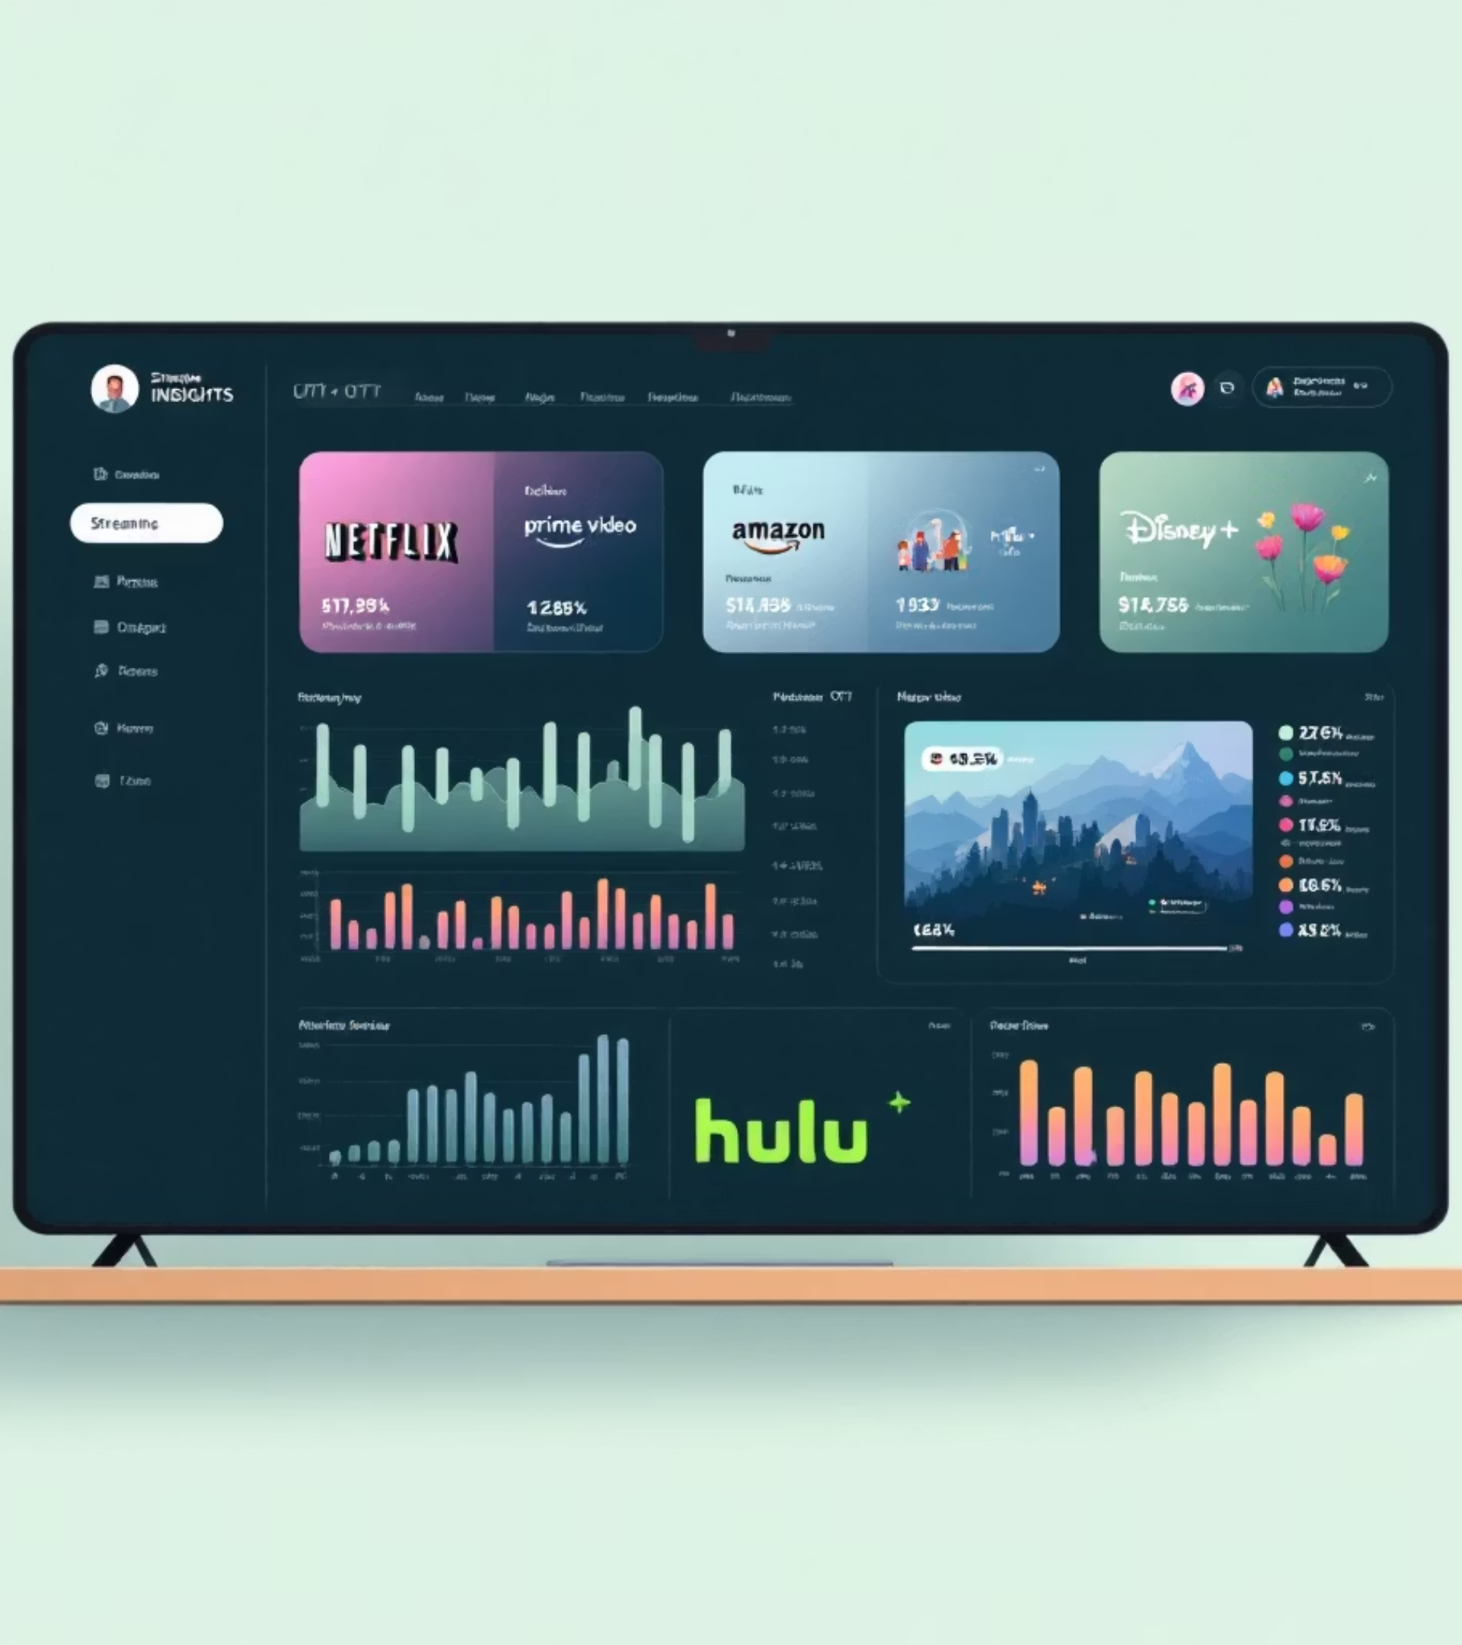
DataFlix: The OTT Intelligence Dashboard
Streaming Insights Reimagined
Team Members:
Aditi Borkar RA2211027010030
Vibhor Pundhir RA2211027010031
Paras Tikoo RA2211027010048
Kenisha Surana RA2211027010078

Slide 2

The Streaming Wars
A Data-Driven Battlefield
The OTT (Over-The-Top) market is booming and fiercely competitive (Netflix, Prime Video, Disney+, Hulu, etc.).
Understanding content strategy, audience preferences, and market trends is crucial for platform success.
Problem
Solution
Accessing and comparing analytics across multiple platforms is difficult. Data is often siloed, making strategic decision-making challenging.
DataFlix - A centralized dashboard providing comprehensive, comparative intelligence for the OTT landscape.

Slide 3
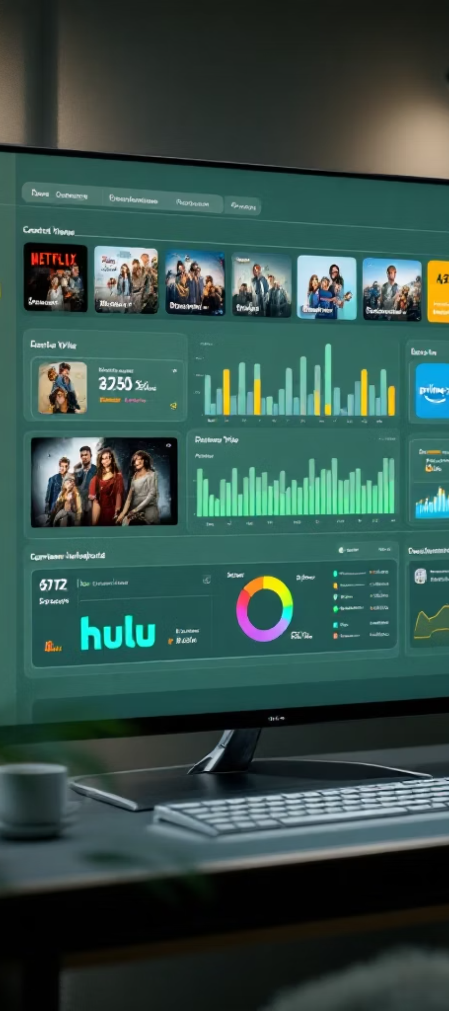
Our Mission
Clarity in the Content Chaos
Goal
Objectives
To develop an interactive, visually stunning dashboard for analyzing and comparing content data from major OTT platforms.
Aggregate data for Netflix, Prime Video, Disney+, and Hulu.
Implement robust data processing to handle inconsistencies.
Create platform-specific dashboards with relevant KPIs and visualizations (~5-10 per platform).
Develop comparative analysis tools (e.g., Head-to-Head).
Integrate real-time data via TMDb API (Trending, Search, Reviews).
Deliver a professional, aesthetically pleasing UI/UX with modern design principles (Glassmorphism, Animations).
Generate automated BI-level insights and recommendations.

Slide 4
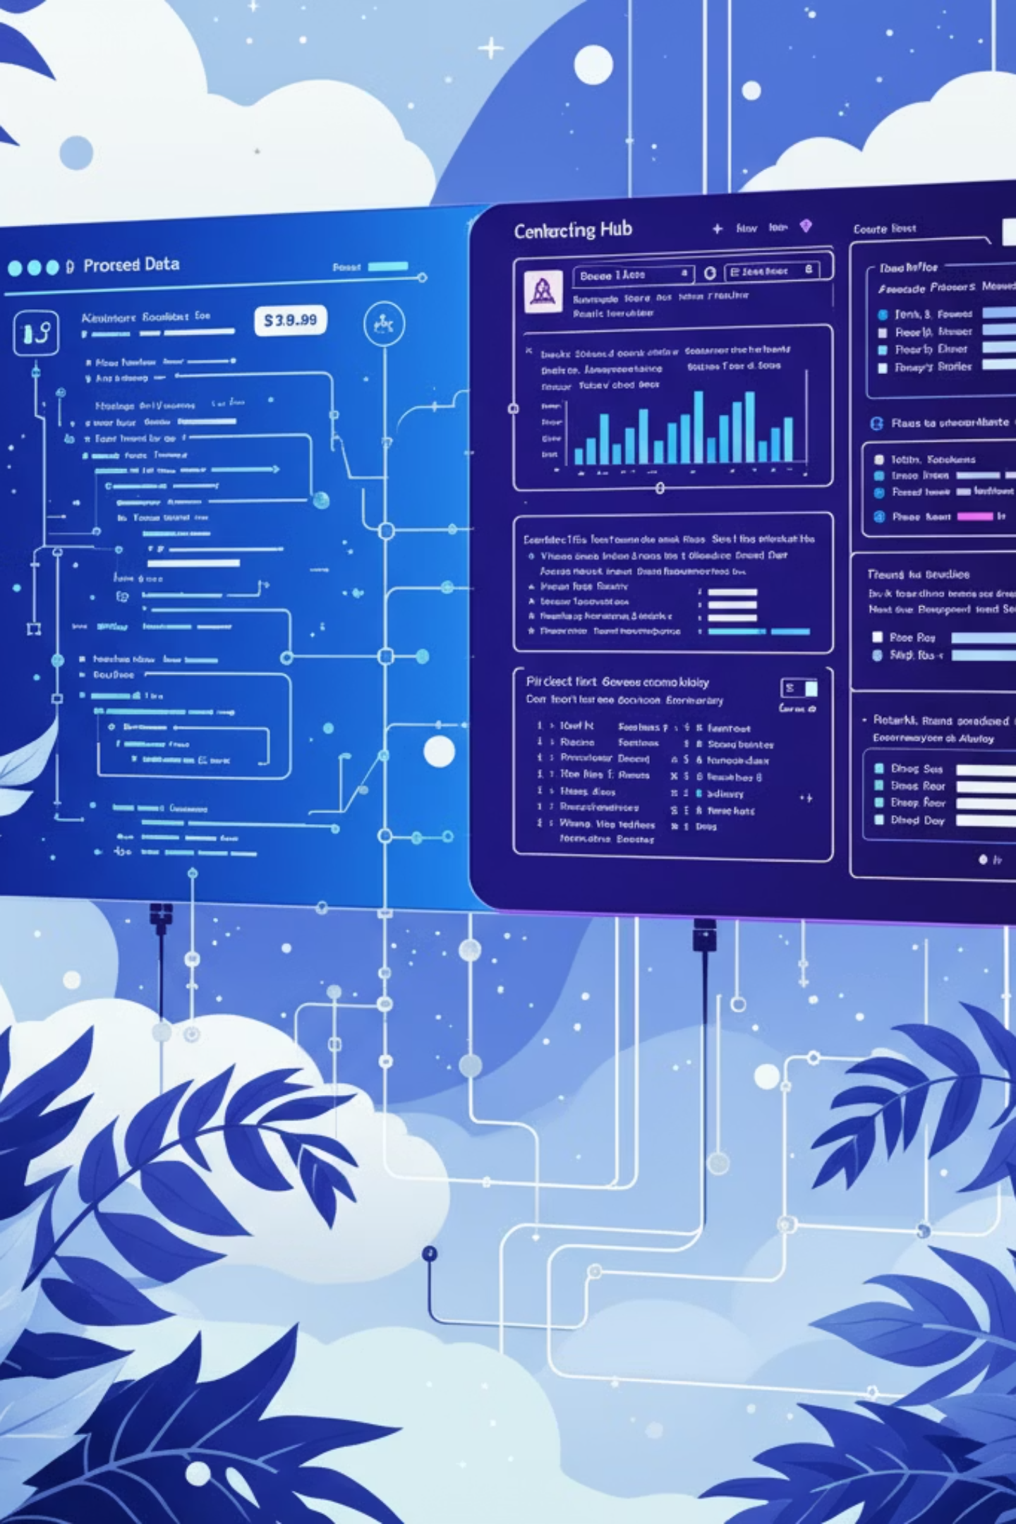
Fueling the Engine: Data Acquisition
Primary Datasets
Real-time Enrichment
Sourced from Kaggle, containing historical metadata for thousands of titles across the four platforms.
The Movie Database (TMDb) API
Used for: Fetching current trending movies, searching specific titles, retrieving posters, overviews, ratings, and user reviews.
netflix_titles.csv
amazon_prime_titles.csv
disney_plus_titles.csv
Enhances the dashboard with up-to-date information and richer context.
hulu_titles.csv
Data Loading
Utilized Python's Pandas library (pd.read_csv) for efficient data loading into DataFrames.

Slide 5

Refining the Raw Material: Data Processing Pipeline
01
02
03
Loading & Initial Inspection
Handling Missing Values
Standardizing Formats
Loaded individual CSVs using Pandas. Checked initial shape, data types (.info()), and missing values (.isnull().sum()).
Strategically filled or dropped NaNs based on column importance (e.g., filled missing country/director with "Unknown", dropped rows with critical missing info if necessary).
Dates: Converted date_added columns to datetime objects (pd.to_datetime, handled errors='coerce'). Extracted year_added, month_added for analysis.
Durations: Parsed inconsistent duration strings (e.g., "1 Season", "10 Seasons", "120 min"). Extracted numerical values using string methods (.str.replace, .str.extract) and converted to integers (pd.to_numeric, handled errors='coerce'). Handled edge cases like "Unknown".
04
05
Splitting Multi-Value Columns
Data Type Conversion
Columns like listed_in (genres), director, cast, country often contain multiple values separated by commas.
Ensured numerical columns (like release_year, duration_int) were correctly typed for calculations and visualizations.
Used Pandas' .str.split(', ').explode() method to transform these into individual rows for accurate counting and analysis (e.g., one row per genre per title).
Result: Clean, standardized, and analysis-ready DataFrames for each platform.

Slide 6









The Building Blocks: Technology Stack
Language
Dashboard Framework
Data Manipulation
Python 3 (Versatile, rich data science ecosystem).
Streamlit (Rapid development, interactive widgets, easy deployment).
Pandas & NumPy (Core libraries for data cleaning, transformation, and analysis).
Data Visualization
External API
Styling
Plotly Express & Plotly Go (Interactive, beautiful, modern charts; supports animations and themes like seaborn). Matplotlib (Used implicitly by some libraries like WordCloud).
TMDb API (Accessed via requests library for real-time movie/show data).
Custom CSS (For advanced visual customization - Glassmorphism, gradients, hover effects).
Animations
Environment
(Optional) Code Editor
streamlit-lottie (Integrating Lottie JSON animations for loading screen and KPIs).
Virtual Environment (venv) for dependency management.
Visual Studio Code (Integrated terminal, debugging).

Slide 7





Inside DataFlix: Features & Capabilities
Unified Home Page
Platform-Specific Dashboards (x4)
BI Insights Engine
Global KPIs summarizing the entire dataset.
Automated, data-driven recommendations presented in an expander below each dashboard.
Interactive Market Share donut chart.
Dedicated pages for Netflix, Prime Video, Disney+, Hulu.
Clickable logos for platform navigation.
"Head-to-Head" comparison tool.
Animated KPI cards with Lottie icons.
TMDb-powered Search (with details & reviews).
Multi-tab layout (~4 tabs per platform).
TMDb-powered Trending Titles section.
~5-10 Interactive Plotly Visualizations per dashboard (pies, bars, lines, areas, histograms, choropleth maps, scatter plots, treemaps, funnels, polar charts).
Platform-specific color themes.
Sidebar filters (Content Type, Release Year).
Aesthetic Enhancements
Modular Code Structure
Custom CSS, loading animation, background music toggle.
Organized into components and utils for maintainability.

Slide 8
Lessons Learned & The Road Ahead
Challenges Faced
Data Inconsistencies
Multi-Value Columns
Handling varied date formats, duration strings ('Unknown', seasons vs. mins), and missing values across datasets required careful cleaning.
Accurately analyzing genres, directors, and countries needed the explode() technique.
API Integration
UI/UX Iteration
Managing API keys securely (st.secrets), handling potential connection errors or missing data gracefully.
Refining the layout, styling (CSS conflicts with Streamlit), and interactivity took several attempts to achieve the desired professional look and feel. (You can mention the journey from the initial simple look to the final version).

Slide 9
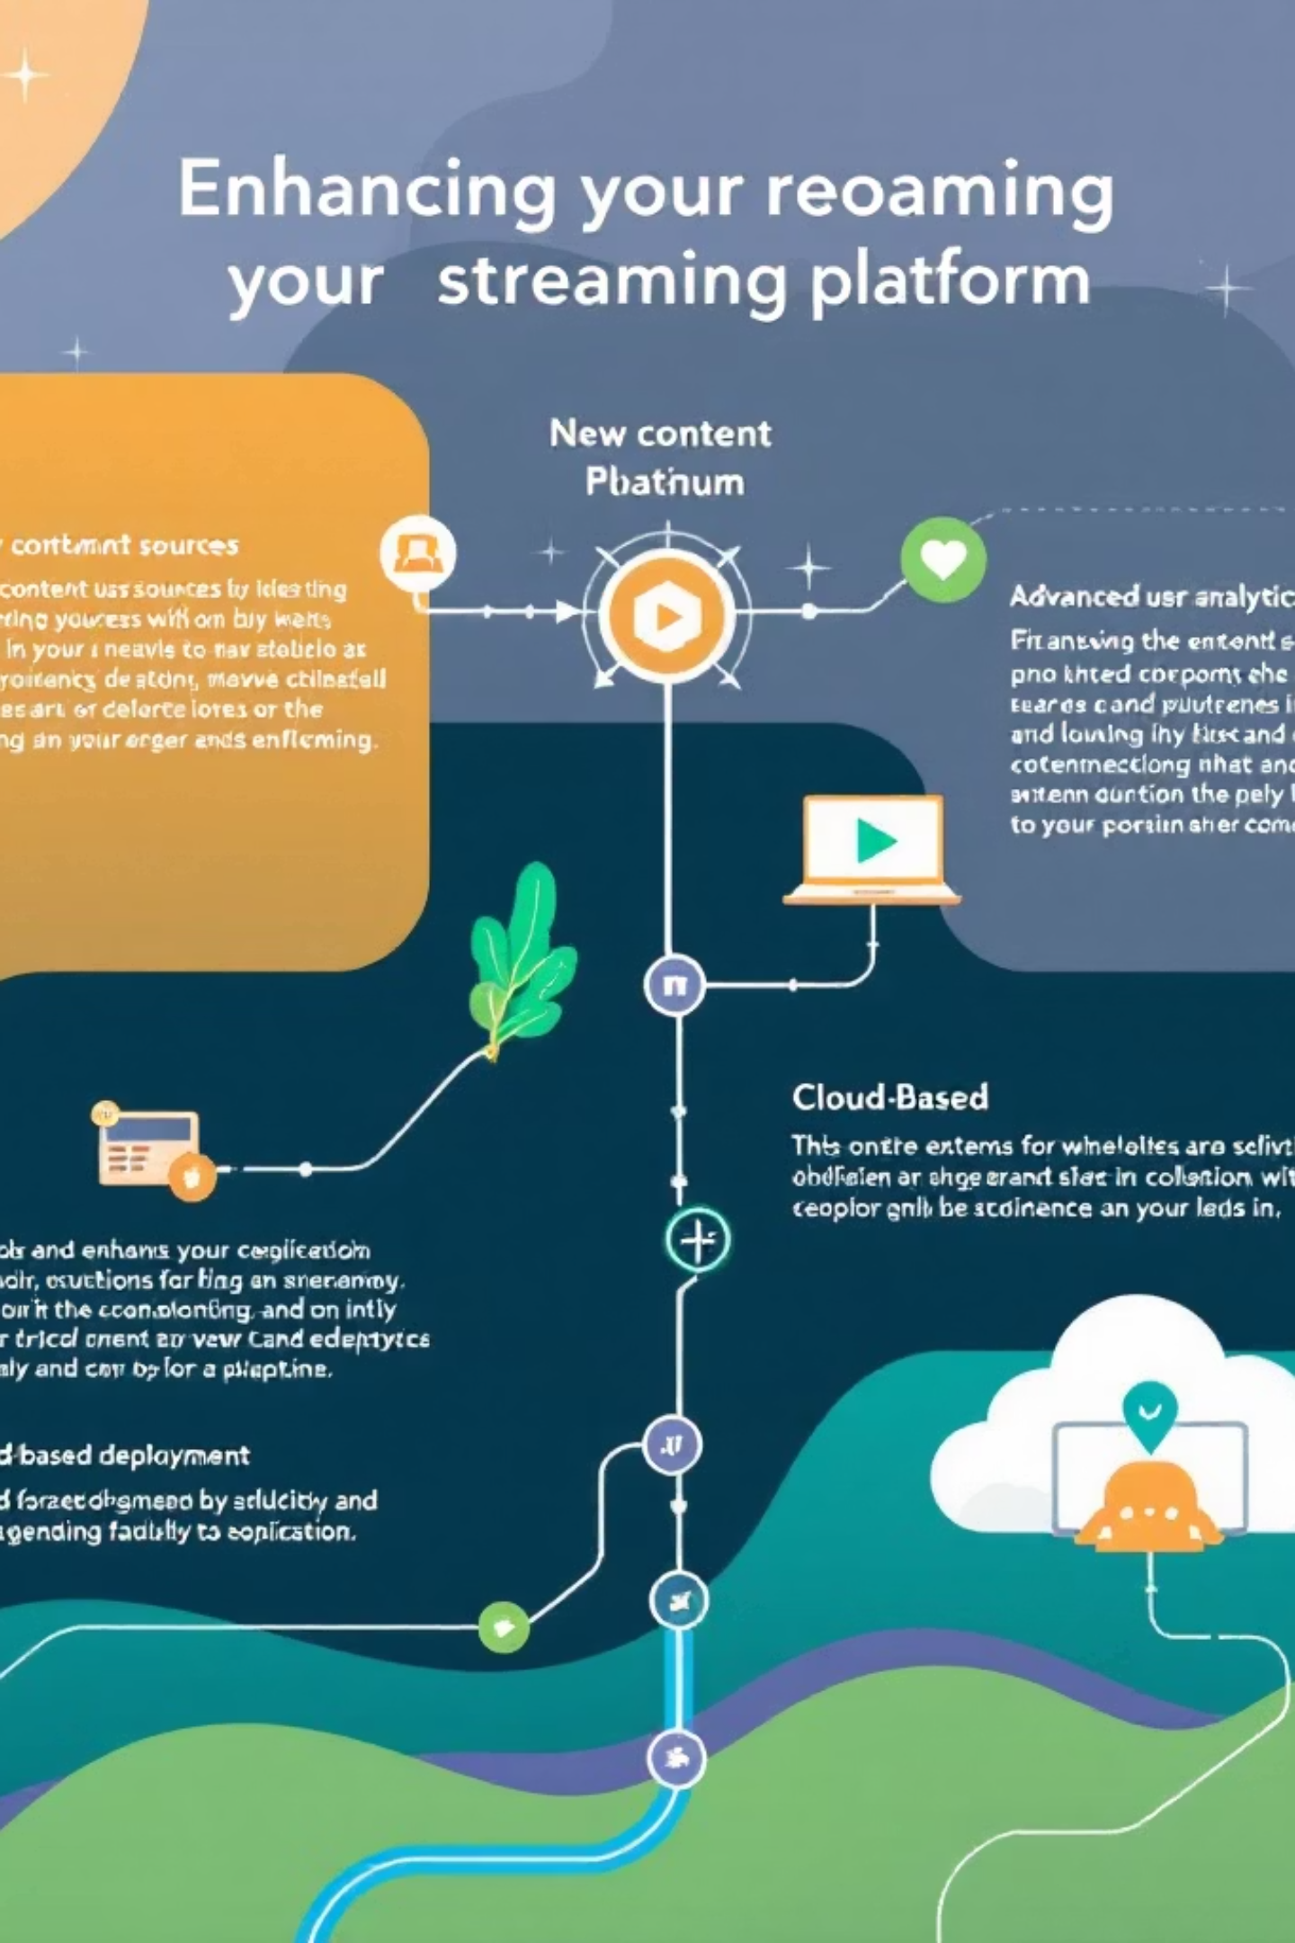
Future Enhancements
Add more streaming platforms (HBO Max, Apple TV+, etc.).
Incorporate user ratings/sentiment analysis from sources like IMDb/Rotten Tomatoes.
Implement more advanced analytics (e.g., predictive modeling for content success, time-series forecasting).
User accounts for personalized dashboards or saving comparisons.
Deployment to a cloud platform (Vercel, Heroku, etc.).

Slide 10
From Data to Decision
DataFlix successfully transforms raw OTT data into a powerful, interactive intelligence tool.
Provides both high-level market views and deep dives into individual platform strategies.
Demonstrates the power of Python, Streamlit, and Plotly for building professional BI dashboards.
Tagline Recap: Truly "Turning Streaming Data into Strategy."
Thank You!

